Slide 1

CIST 2931, Fall 2016
Weekly Report #5
10/31/2016
i c i o u s
Cnrl/alt/Delicious
Steven Alcorn, Zachary Weaver, Tyrus Skipper, Antonio Mosquera, Rupa Shrestha

Slide 2
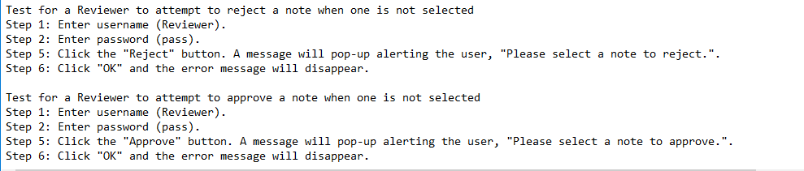
Tests
i c i o u s
Writing the remaining test cases for the user.
Notes:
Antonio

Slide 3
Code
i c i o u s
Added code to enlarge the tabs when in fullscreen.
  //getContentPane().setLayout(new java.awt.GridBagLayout());
  getContentPane().add(tabPane_container);
Added a line of code to set the comment box for the Note Reviewer to set size.
dialog_addComments.setMinimumSize(new java.awt.Dimension(562, 430));
Fixed the Reject button for the Note Reviewer and now the DCP and Note Reviewer can “message” each other when submitting and rejecting a note.
Notes:
Zach

Slide 4
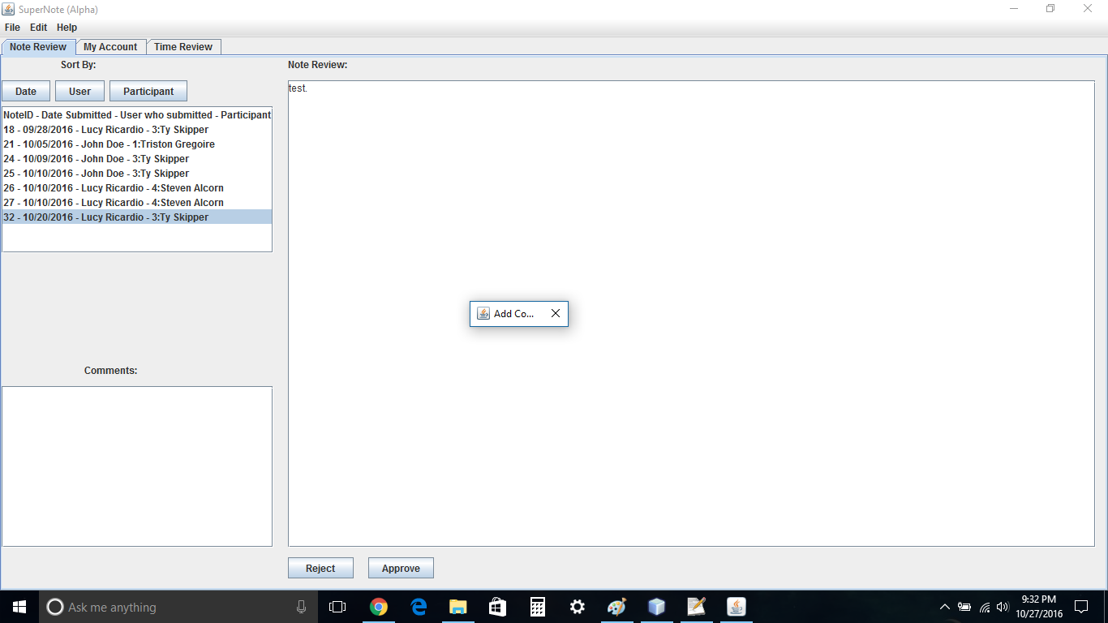
Code
i c i o u s
Notes:
Zach

Slide 5
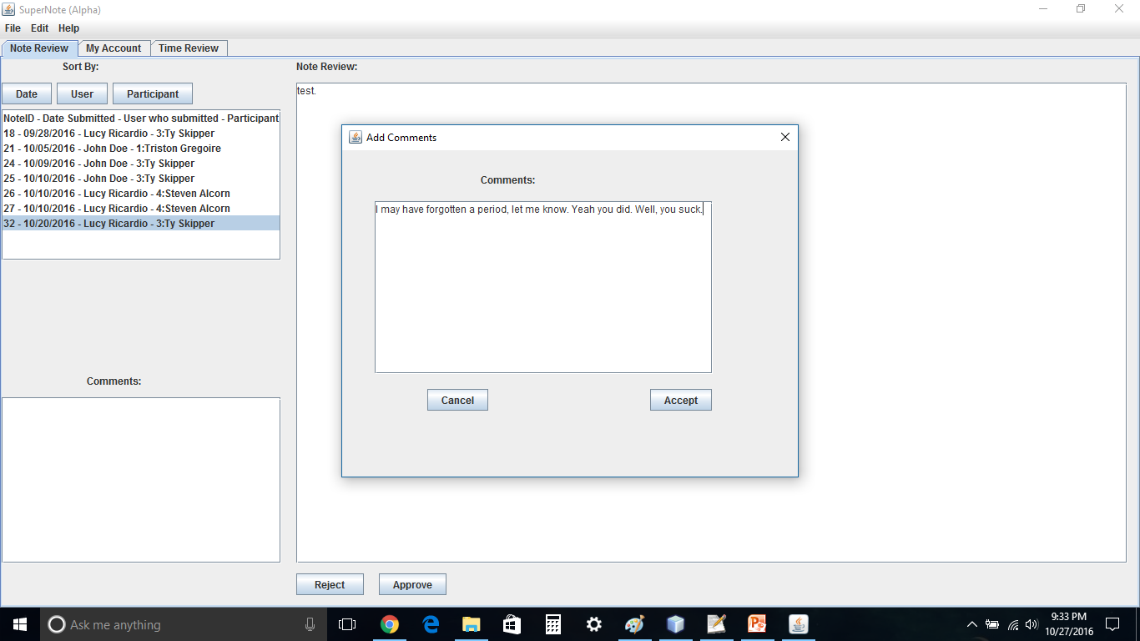
Code
i c i o u s
Notes:
Zach

Slide 6
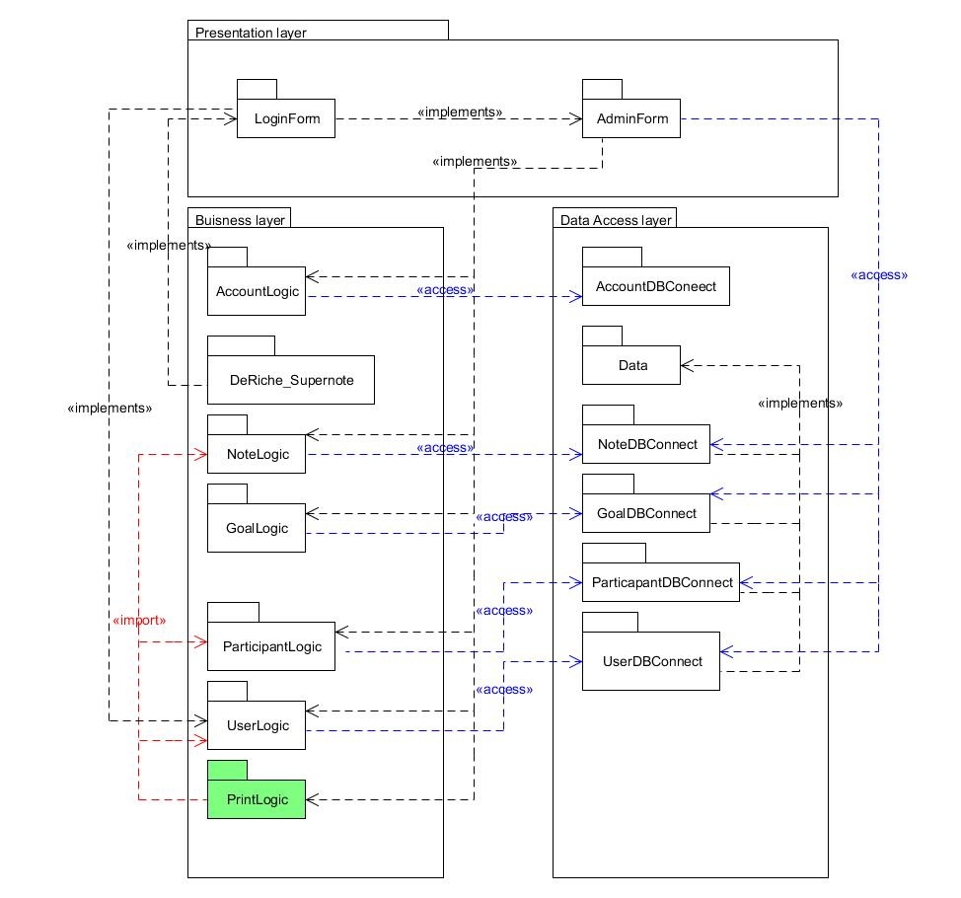
Deliverable
i c i o u s
Notes:
Steven

Slide 7
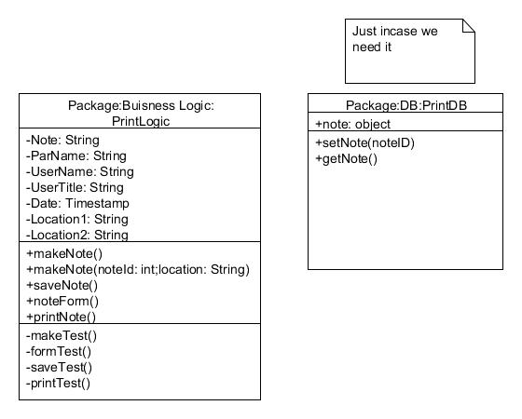
Deliverables
Notes:
Steven

Slide 8
Project Plan
i c i o u s
Start building the PrintLogic class
Notes:
Ty

Slide 9
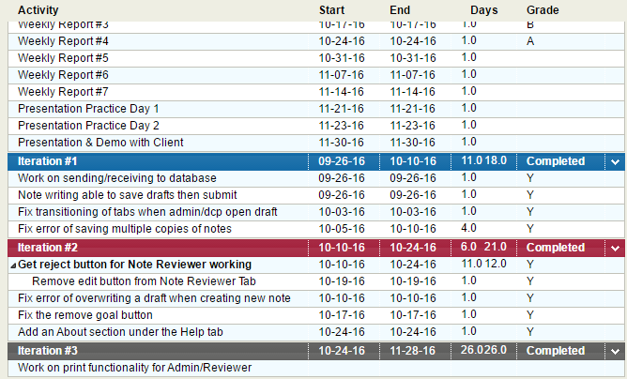
Project Plan for the Semester
Notes:
Ty

